Slide 1
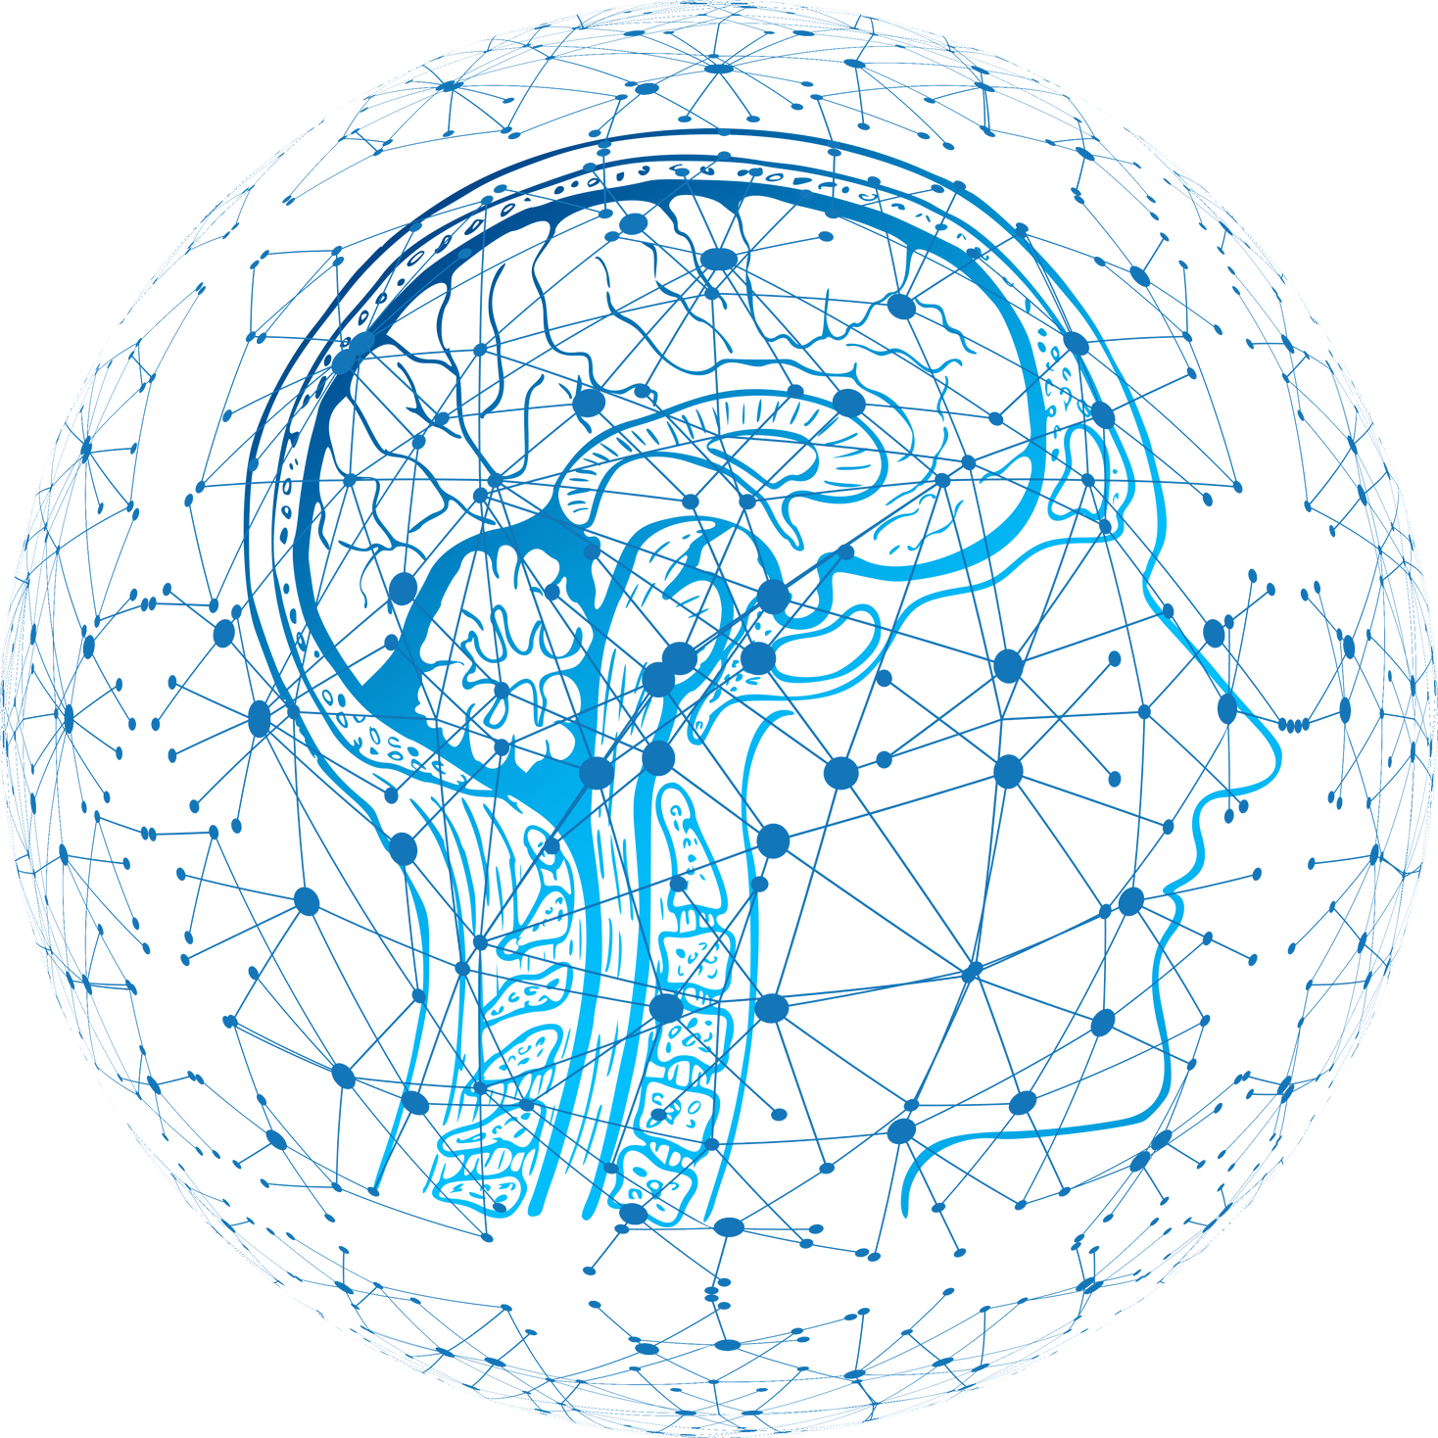





BRAIN TUMOR
SEGMENTATION
MOSTAFA TAREK
MOHAMED
EZZ AL-REGAL
ABD EL-RAHMAN AHMED
AMR SAMIR

Slide 2

Abstract
We employed the U-Net model, leveraging its encoder and decoder architecture, to predict accurate masks for our dataset. Specifically, our dataset involves the segmentation of brain tumors utilizing the T1 format in MRI data."
PYTHON

Slide 3
Introduction
Brain tumors, especially lower-grade gliomas, pose significant challenges in diagnostics and treatment planning.
Accurate tumor boundary delineation from MR images is crucial for effective clinical decision-making.
Deep learning techniques, and UNet architecture, offer avenues for tumor delineation.

Slide 4

What is Tiff format?
A TIFF, which stands for Tag Image File Format, is a computer file used to store raster graphics and image information. TIFFs are a handy way to store high-quality images before editing if you want to avoid lossy file formats.

Slide 5
Data Preprocessing
01
02
set the image and mask width and height 256
make images in rbg and mask in grey scale
03
04
divide data on batch size 32
normalize the data to be from 1 and 0

Slide 6
Data Augmentation
01
02
Rotation
Shiftting
03
04
Zooming
Flibbing

Slide 7
Model Architecture
Our model has 5 encoders and 4 decoders
each encoder and decoder contain Conv2D and activation function ‘relu’ and batch normalization and max pooling
and learning rate 1e-4 using decay learning rate
loss dice coef loss
optimizer Adam
epoch 150

Slide 8

What is U-net?
U-Net is a popular deep-learning architecture for semantic segmentation. Originally developed for medical images, it had great success in this field. But, that was only the beginning! From satellite images to handwritten characters, the architecture has improved performance on a range of data types.

Slide 9
Metrics and loss Used
We employed three scores, namely accuracy score, Dice score, and IoU score, to comprehensively evaluate and measure performance in our analysis.
We used the Dice score loss for calculating the loss for each epoch and for enhancing the weights at each epoch.

Slide 10

road map of building model
01
02
03
Load Images
Data Preprocessing
Data Visualization
04
05
06
Split data into training and testing sets
Data Augmntation
build model Architecture
07
08
09
Train Modle
Evaluate the model with test data
Save weightsodel

Slide 11

Train Scores
model
accuracy
Dice coef
iou
Dice coef loss
U-net
99.8
91.69
85.26
-0.9209
Test Scores
model
accuracy
Dice coef
iou
Dice coef loss
U-net
99.84
90.67
83.14
-0.903

Slide 12
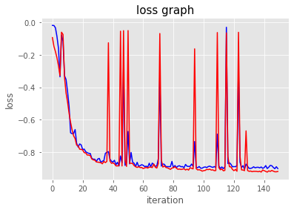
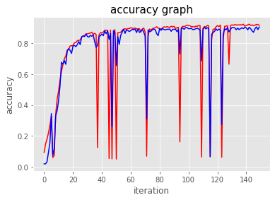
Graphs of history epochs

Slide 13
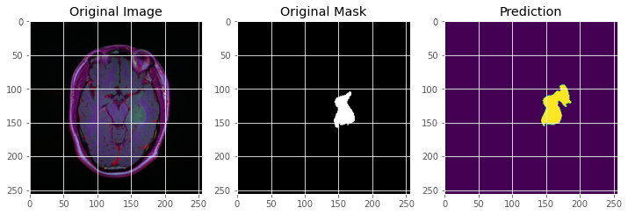
some of Predictions

Slide 14
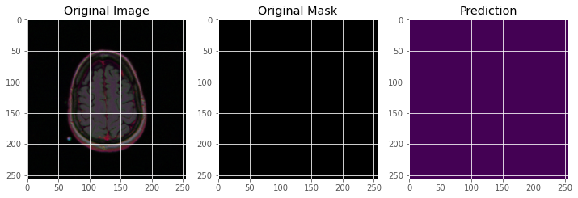
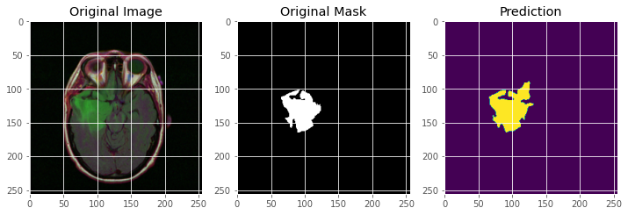
some of Predictions

